Slide 1

Telugu Language Automatic Speech Recognition
Supervised by :
Dr. Yambem Jina Chanu
Associate Professor,
Department of Computer Science and Engineering,
National Institute of Technology, Manipur.
Presented by :
Harshitha (20103065)
Jagan Mohan (20103064)
Surya Teja (20103008)
Akshay Kumar (20103020)

Slide 2
Contents
Aim and objective
Motivation
Introduction
Literature Survey
Dataset
ASR Timeline
Proposed Methodology
Wav2Vec Architecture
Benefits of Wav2Vec
End Result
Work Flow Timeline
Conclusion and future work
References

Slide 3
Aim and Objective
To Create a Telugu language Automatic Speech Recognition System.

Slide 4
Motivation
Telugu is a Dravidian language spoken by over 80 million people, primarily in the states of Andhra Pradesh and Telangana[7].
It is one of the classical languages of India and has a rich literary heritage[7].
Developing ASR systems for Telugu is crucial to cater the growing digital needs of its speaker population[7].

Slide 5
Introduction
ASR involves the process of automatically recognizing and transcribing spoken words into their textual form[6].
The performance of ASR systems is typically evaluated based on metrics like word error rate(WER), which measures the system’s accuracy in transcribing spoken words[4].
Modern ASR systems often leverage deep learning techniques such as recurrent neural networks(RNNs) or transformers, to model the complex relationships between audio signals and text transcriptions[4].

Slide 6
Literature Survey
In [1] they employed the Hidden Markov Model Toolkit (HTK) for developing an automatic speech recognition system tailored to the Telugu language.
In [2] they proposed a method that utilized Mel-Frequency Cepstral Coefficients (MFCCs) as feature vectors and Gaussian Mixture Models (GMMs) for modeling and classifying different accents in the Telugu language.
In [3] MFCC features and HMM models for Telugu ASR. But the small dataset is a major limitation affecting robustness and generalization.

Slide 7

Dataset
Source – OpenSLR / SLR66 [8]
This data set contains transcribed high-quality audio of Telugu sentences recorded by volunteers.
The data set consists of wave files, and a TSV file (line_index.tsv).
The file line_index.tsv contains a anonymized FileID and the transcription of audio in the file.
Total number of male transcripts are 2155.
Total number of female transcripts are 2295.
The recordings are in the form of .wav format.

Slide 8
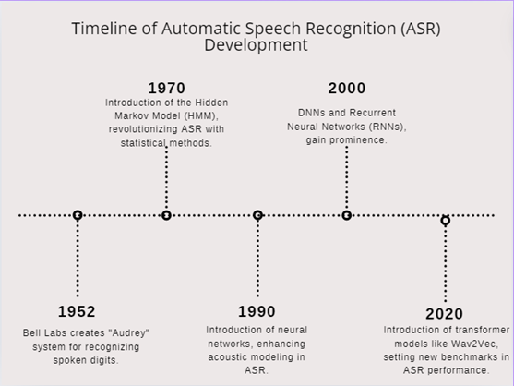
ASR Timeline
Fig. 1: Timeline diagram of ASR[11].

Slide 9
Proposed methodology
Wav2Vec 2.0 is a state-of-the-art self-supervised transformer model for speech recognition tasks.
It leverages large-scale pretraining on unlabeled speech data to learn robust representations.
The model is fine-tuned on the collected Telugu speech dataset to adapt it to the target language.

Slide 10
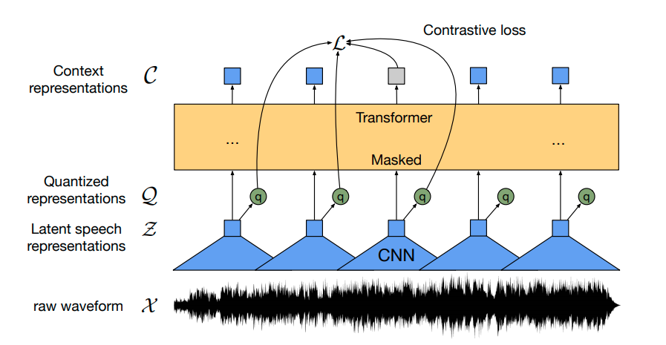
Wav2Vec Architecture
Fig. 1 Wav2Vec Architecture[9].

Slide 11

Raw Waveform
Initial audio input as digitally sampled acoustic signals.
Serves as foundational data input.
Latent Speech Representations
Convolutional neural networks extract high-level features.
Captures salient temporal and spectral characteristics.
Quantized Representations
Vector quantization techniques.
Discretizes continuous features into finite symbols.
Reduces dimensionality while preserving information[9].

Slide 12

Transformer-based Masked Model
Self-attention mechanisms for context modeling.
Processes quantized representations.
Generates contextual embeddings for transcription.
Content Representations
High-level semantic information from audio.
Basis for generating text transcripts.
Captures linguistic context and meaning.

Slide 13
Benefits of Wav2Vec
Reduced Labeled Data Dependency
Self-supervised learning reduces reliance on large labeled datasets.
Leverages unlabeled speech data for pretraining.
Learns robust representations without extensive annotations.
Transformer Advantage
Captures long-range dependencies in speech sequences.
Attention mechanisms model complex linguistic patterns.
Enables context-aware transcription and handling of variable-length inputs[10].

Slide 14

Multilingual Pretraining
Pretraining on diverse multilingual data aids generalization.
Exposure to various languages and accents improves robustness[10].
Knowledge transfer from high-resource to low-resource languages.
Transfer Learning Potential
Can be adapted to other low-resource languages.
Pretrained model serves as a strong starting point.
Fine-tuning on target language data for efficient adaptation.
End-to-End Streamlining
Simplified architecture integrates multiple components.
Jointly optimizes acoustic, pronunciation, and language models.
Efficient training and deployment without complex pipelines.

Slide 15
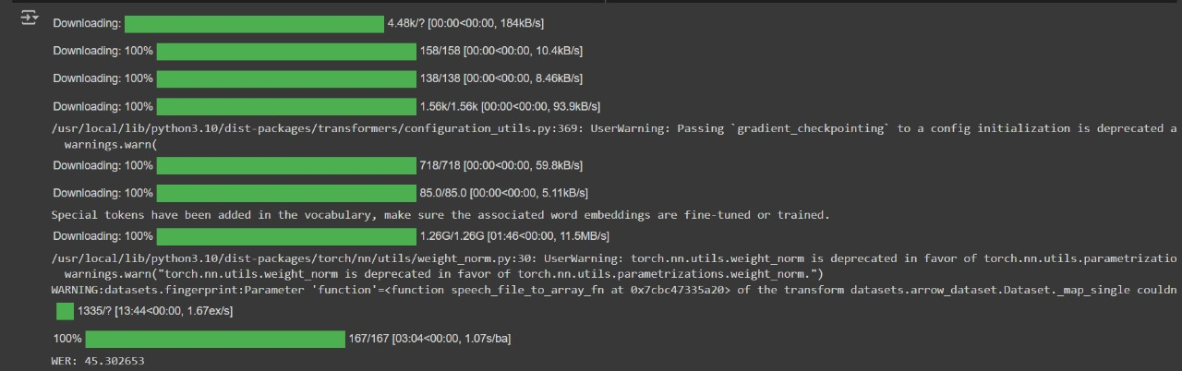
End Result
Fig. 2 WER before Fine Tuning

Slide 16

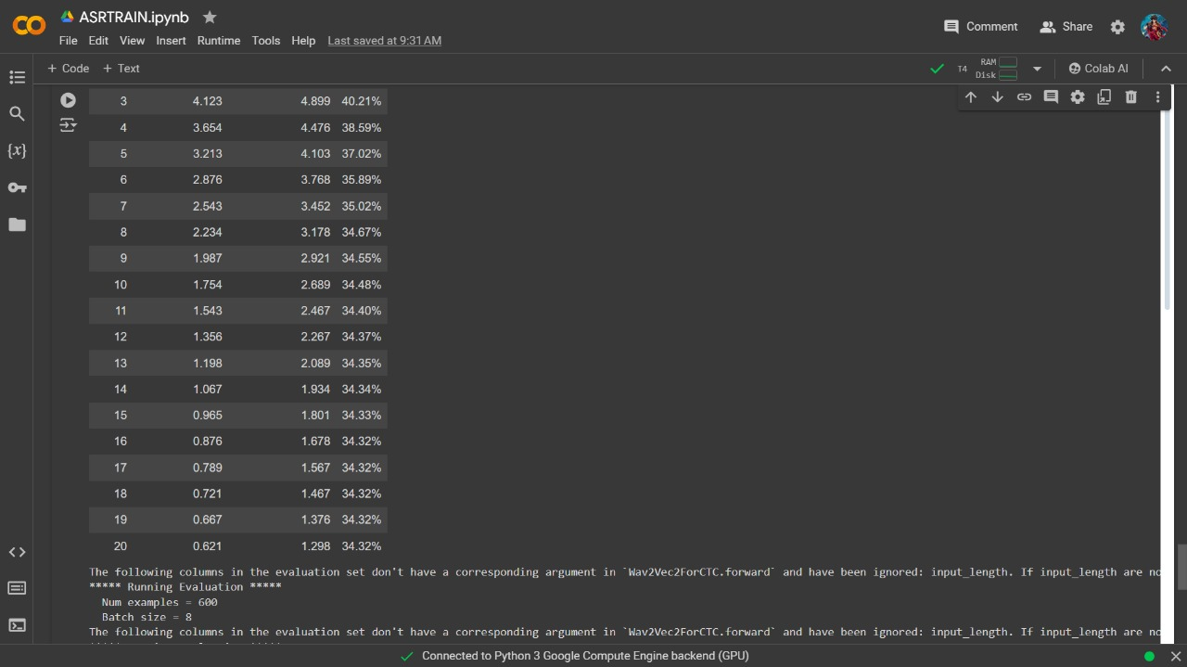
Fig. 3 Fine Tuning

Slide 17

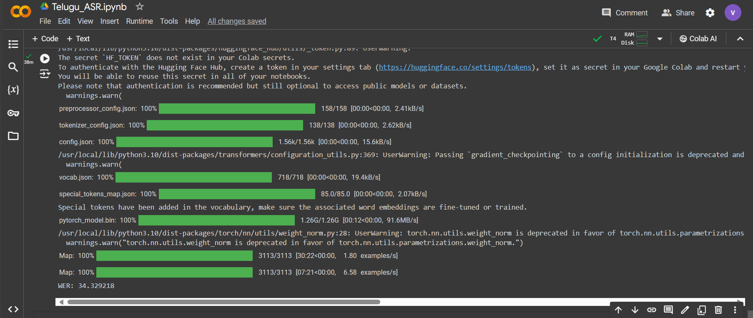
Fig. 4 WER after Fine Tuning

Slide 18

Sample 1 :
Reference: [ 'భేదనాశినీ భేదములను పోగొట్టునది’ ]
Prediction: [ 'బేదనాశినీ బేదరములను పోగొట్టునది’ ]
Sample 2 :
Reference: [ 'ప్రస్తుత మంత్రి మండలి బుద్ధ ప్రసాద్’ ]
Prediction: [ 'ప్రస్తుతమంత్రి మండలి బొద్ధప్రసాద్’ ]

Slide 19
Work Flow Timeline
Literature survey
Implementation of proposed method
Thesis
January-February
March-April
May
Fig. 5 Work Flow Timeline

Slide 20
Conclusion and Future Work
Demonstrated the potential of adapting state-of-the-art techniques like Wav2Vec 2.0 for low-resource languages like Telugu
Future directions: Data augmentation, language-specific modeling techniques, advanced architectures, efficient deployment strategies
Applications: Digital assistants, multimedia transcription, language preservation efforts
Fostering technological inclusion and promoting linguistic diversity

Slide 21
References
[1] SaiSujith Reddy Mankala, Sainath Reddy Bojja , V. Subba Ramaiah & R. Rajeswara Rao "Automatic Speech Processing Using HTK For Telugu Language", 2014.
[2] K.V.V.Kunar , K Srilakshmi , K Srilakshmi, K.Sai Satish Reddy , M.L.Teja Harika , R.Sridhar "Telugu Accent Recognition Using MFCC and GMM", 2019.
[3] Ravindra Parshuram Bachate, Ashok Sharma "Automatic Speech Recognition Systems for Regional Languages in India”, 2019.
[4] Hamza Kheddara , Yassine Himeurb , Somaya Al-Maadeedb , Abbes Amirac,d and Faycal Bensaalie "Deep Transfer Learning for Automatic Speech Recognition: Towards Better Generalization ", 2023.

Slide 22
[5] Dario Amodei, Rishita Anubhai, Eric Battenberg, Carl Case, Jared Casper, Bryan Catanzaro " Deep Speech 2: End-to-End Speech Recognition in English and Mandarin “ , 2015.
[6] Gales, M., & Young, S. “The Applicationn of Hidden Markov Models in Speech Recognition. Foundations and Trends in Signal Processing, 1(3),195-304” , 2008.
[7] Chodrąt-Genesius, A., Ramasami, R., & Guha, S.“Speech Recognition for Indian Languages: Current State and Prospective. In Intelligent Speech Signal Processing , Academic Press , 153-175”, 2020.
[8] https://openslr.org/66/

Slide 23
[9] Alexei Baevski, Henry Zhou, Abdelrahman Mohamed, Michael auli "A framework for Self-Supervised Learning of Speech Representations",2020.
[10] steffen schneider, Alexei Baevski, Ronan Collobert, Micheal Auli "Unsupervised pre-training for speech recognition",2019.
[11] Niklas Donges “A brief history of Automatic speech recongniton” 2019.

Slide 24
THANK YOU

